Slide 1
Maintenance Project Requirements Analysis
Lecturer: Ngo Huy Bien
Software Engineering Department
Faculty of Information Technology
VNUHCM - University of Science
Ho Chi Minh City, Vietnam
nhbien@fit.hcmus.edu.vn

Slide 2

Objectives
To write a software requirements specification for a maintenance project.

Slide 3

Contents
Existing Use Cases.
Affected Features.
Affected Roles.
Existing Architecture.
Proposed Future Architecture.

Slide 4

References

Slide 5
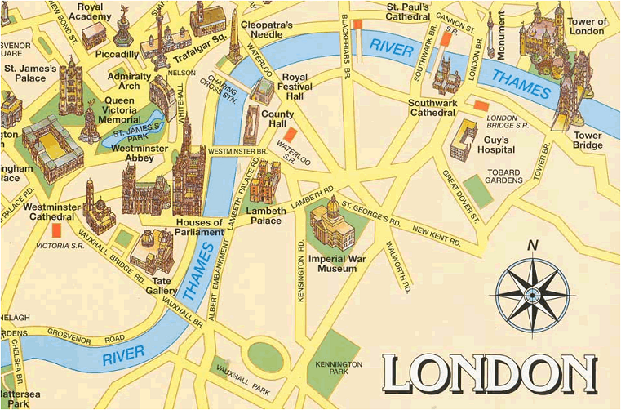


Why Maintenance Project Failed?
No requirements analysis.

Slide 6


The Core Idea
Indentify problems in an existing solution.
Solution space → Problem space.
Requiring both technical experts and domain experts.

Slide 7

Where Do We Begin?
Messages (we often hardly understand what they said).
Documents (they are often a mess).
Existing systems (we hardly understand what they do).

Slide 8
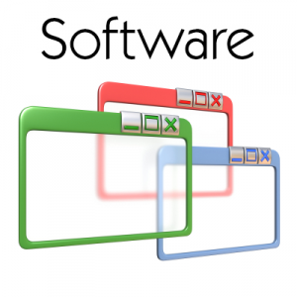

1. Collect Existing Artifacts
List of current software products that are used and their purposes.
User guide (or requirements specification) of each software product if available. If the user guides (or requirements specifications) are not available then screenshots or captured videos or account to review the systems may help.
Installation guide (or design specification) of each software product if available. If the installation guides (or design specifications) are not available then any deployment schema or notes of physical servers' purpose may help.

Slide 9


2. Clarify Terminologies
Talk with experts, read user guide.
Build a glossary and reference sources.

Slide 10
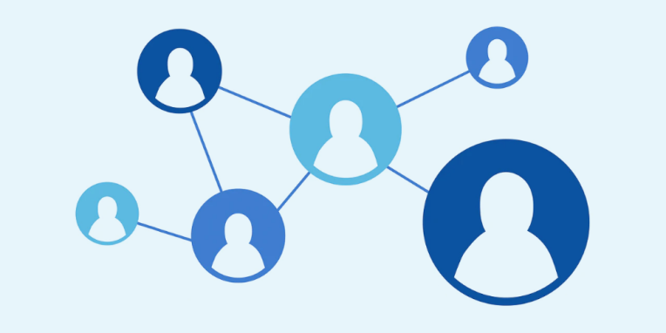
3. Who Uses the System?
Roles
Admin
User
Reviewer

Slide 11

4. What Exists in the System?
Begin with a user guide or an existing system or a similar system if they are available.
Walk through the existing user interfaces to determine related roles and use cases.
→ Optionally create domain models.

Slide 12
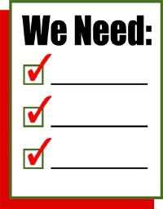

5. Collect Business Problems or Needs
List of current business problems or needs (a list or notes or diagrams).
It is fine that you may not understand the needs at all.

Slide 13
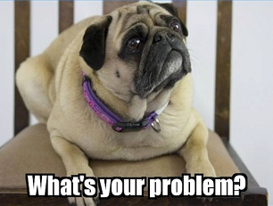
6. Distill Navigation Flow and UIs
Begin with a draft business needs → Try to find out the exact screens in the existing system related to customer's problems or needs.
If you cannot understand the problems or the needs, try to clarify terminologies first.
There is NO NEED to understand the technical problems when identifying the screens.
How are key business processes affected by the current solution (records/fields not populated or populated incorrectly, screens take time to appear, saving data is too slowly, new business processes are not supported, etc.)?

Slide 14
7. Clarify Terminologies
Ask for example values, files, tools for doing something related to unclear or ambiguous terms.
"Create the ability to upload coordinated count data and have is stored in a temporary location, so it can be analyzed in R for an administrative and/or senior user to determine the validity of the data by observer, before finalizing the data for complete analysis. Additional information: The authorized user would be able to mark the valid observations and the invalid observations."
Could you please provide
an example “coordinated count data” file (.XLS),
an example location path to which you wish to store the file (a SAN server?),
and the way and/or the tool that you use to interact with the uploaded “coordinated count data” example file (hands-on demonstration)?

Slide 15

8. Identify Correct Problems
Asking for demonstration of the issues or limitations of the current system, step-by-step illustrated examples with actual existing values.
Drawing sketches for the guessed need using a pencil or a tool.
https://www.adobe.com/products/xd.html
https://www.figma.com/

Slide 16
9. Identify Correct Needs
Asking for user guide, video demonstration of a feature.
Asking for 3rd party installation files and custom scripts if available.
Asking for example input data and output reports.

Slide 17
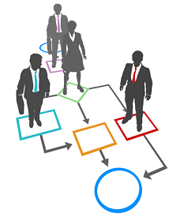
10. Document Business Needs
Create use cases
Steps
UIs (mockups)
Additional data inputs/outputs (files)
Additional logic (text)
There might be a need of review of the existing source code and database to indentify initial draft technical solutions when creating these use cases to ensure that they are feasible.

Slide 18

11. Identify Affected Features
Revise the use cases with additional
Steps
UIs (mockups)
Data inputs/outputs (files)
Logic (text)
There might be a need of review of the existing source code and database to indentify initial draft technical solutions when identifying the affected features.

Slide 19
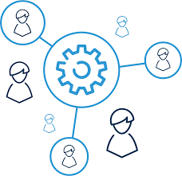
12. Identify Affected Roles
Revise the use cases with additional or new business rules for all related roles.

Slide 20


Slide 21
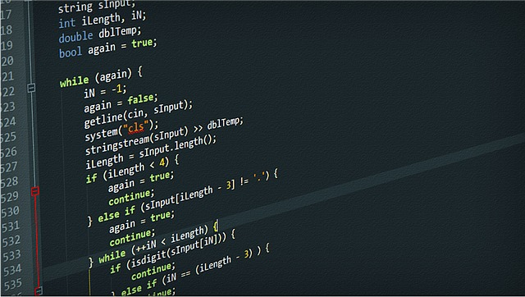
1. Collect Existing Technical Artifacts
Current database or data schemas.
Current software products and source code if possible.

Slide 22

2. Run the Legacy Source Code
Alternatively, install tools related to existing source code, then build and run the existing source code and database if they are available.
Walk through the existing external interfaces to determine primary roles and use cases.
→ Optionally create domain models.

Slide 23

3. Collect Technical Problems or Needs
List current technology issues using notes or diagrams.

Slide 24

4. Analyze Technical Problems
Data integrity issue: missing/duplicated fields? missing/duplicated rows
Performance issue: Too many rows to handle by current software?

Slide 25
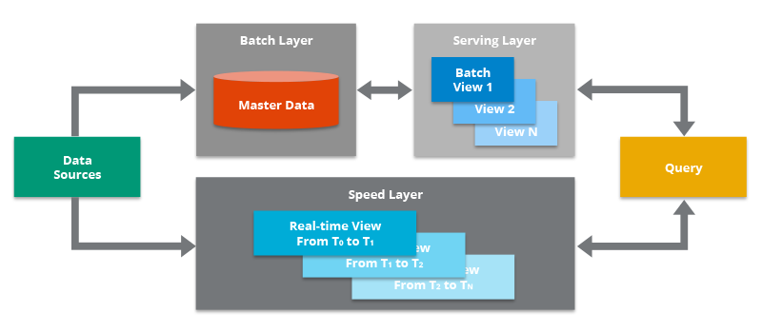
5. Document Technical Needs
Create an existing architecture
and a proposed future
architecture
Components
Tools
Additional data inputs/outputs (files)
Additional logic (text)
There is surely a need of review of the existing source code and database to indentify draft technical solutions when creating existing architecture and a proposed future architecture.

Slide 27
Confirmation of Legacy Systems
Examples might be access to legacy systems, captured UI screenshots of each sub-systems, parts of database schemas, example data, example legacy source code, legacy codebase.

Slide 28
Confirmation of Problems
Examples might be lack of documentation and expertise, non-scalable architecture, high cost development for new features, unfriendly UI/UX, performance issue.

Slide 29
Confirmation of Goals
Examples might be migration of the legacy system to event-driven, cloud based microservice architecture with modern UI/UX.

Slide 30
Confirmation of Project Budget
Project budget: Used to select appropriate technologies. Some cloud services, e.g. Salesforce Platform or AWS relational databases, might be very expensive.

Slide 31
Confirmation of Initial Text or Diagrams
Ask for clarifications of ambiguous terms or components. Does initial proposed solution just need to be general? Should proposed architecture need to be adapted to specific problems, needs, legacy codebase, existing data, and budget?

Slide 32

Thank You & See You Again

